Slide 1

COMMON UI mistakes
When making prototype, avoid these
*pictures taken from: https://careerfoundry.com/en/blog/ui-design/common-ui-design-mistakes/

Slide 2
UI and Software engineering
UI is not specifically a part of software engineering, but making a prototype is.
Having an impressive prototype can leave a lasting effect and work in your favor.

Slide 3
Maintain consistency
If the menu is inconsistent, it will keep the users confused
Inconsistent menu does not look pleasing to the eye
It also makes navigating the content harder

Slide 4
Maintain consistency
Consistent use of color palette
Consistent font styles for titles, paragraphs, links, etc.
Use either rounded or squared corners for the shapes in your app: Icons, cards, buttons, etc.
Consistent line thickness: for icons, dividers and any other lines you use.
Every element that deviates in any way must have a reason to do so.

Slide 5
Color palette
Adobe color wheel

Slide 6
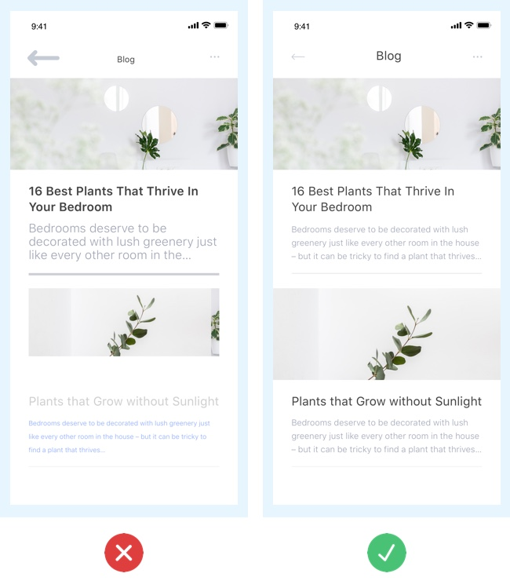

Slide 7
Using default elements and values
Default buttons
Default colors
Default fonts
Default shadows (should be subtle)

Slide 8
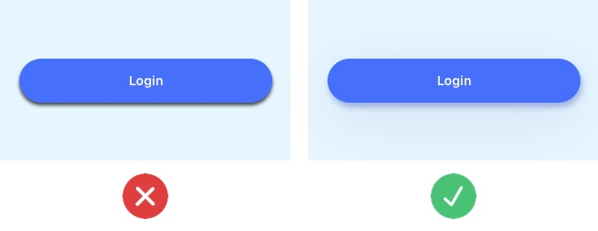

Slide 9
Little distinction between primary and secondary buttons
Use different visual weight. The one with stronger color will be noticed first
Do the contrary to the secondary buttons

Slide 10
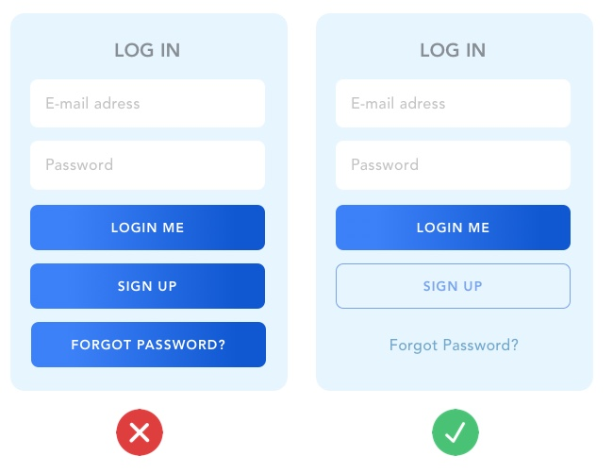

Slide 11
Lack of text hierarchy
Have plenty of contrast between each style title: Use size, weight, and color to separate each style.
For information hierarchy to be clearly visible, always start with a big title which should be the most prominent element of the page. Sub-headers and other text should be considerably smaller, and so on.
Use adequate spacing.
Separate your blocks of text clearly, use small amounts of space to connect related information and use lots of space to visually separate different blocks of information.

Slide 12
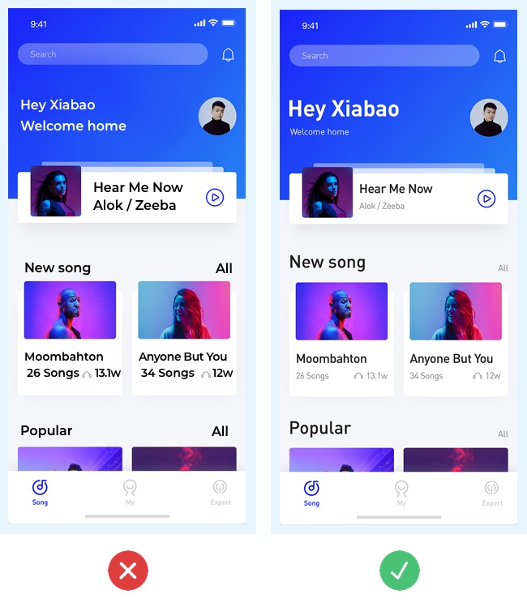

Slide 13
Bad iconography
Icons are an important part of modern UI, especially for mobiles
Using the right icon is important to convey the proper meaning
Use vectors / SVG for your icons. It’s the easiest way to ensure your icon will look sharp in any device or resolution.
Use a consistent style: First of all, all of your icons should either be outlined or filled. In addition, ensure a consistent line thickness and corner radius.

Slide 14
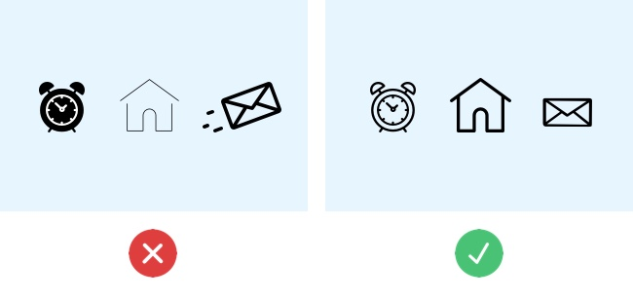

Slide 15
aligned elements
Keeps things tidy and consistent
Easy to follow the design
Related items should be aligned to one side

Slide 16
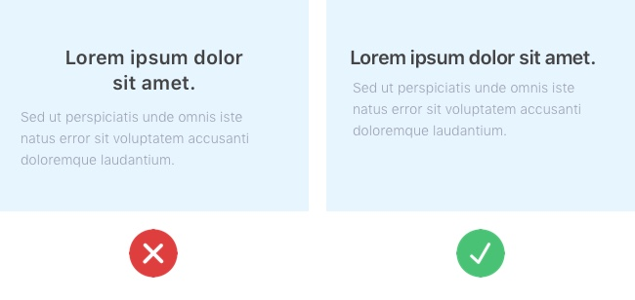

Slide 17
LOW contrast
When you have low contrast between your interface elements, all of the elements merge together and you end up with a dull and hard-to-read interface
Use contrast to guide the user’s attention through your interface.
Use contrast to clearly separate the different sections of your app. For example: use different background colors to show a clear difference between header, content, and footer.
Use contrast to separate elements from the background. Example: Photos with text on top can be hard to read, so ensure your text will be legible by having high contrast between your photo and text.

Slide 18
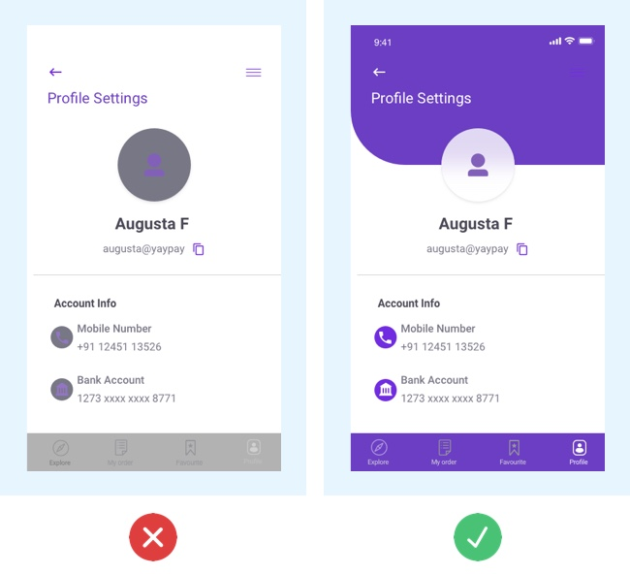

Slide 19
Confusing forms
Avoid only using color to indicate error. Always give actionable feedback to ease the process for a correct entry.
If the form is too long, consider breaking it up into logical sections and show a progress bar or numbers to indicate what step the user is at.

Slide 20
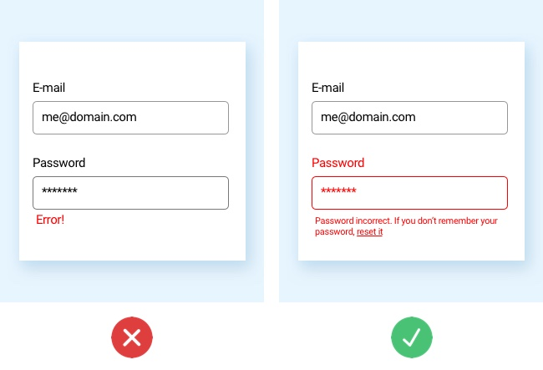

Slide 21
Poor touch target on mobile and tablet
Create finger-friendly targets by keeping in mind that the average width of an adult index finger is 1.6 to 2cm.
Make your touch target at least 45-57 pixels wide. This will give users enough room to hit the target without having to worry about accuracy.

Slide 22
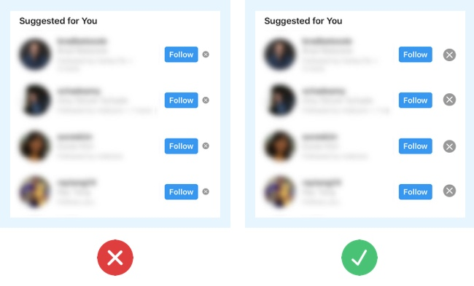

Slide 23
Some important don’ts
Never use comic sans font no matter how much it appeals to you
Be mindful of tab order. A lot of users move around with a keyboard
When designing, colorblind people should be considered
For mobile application, try to make the UI for one hand navigation
Try to keep almost the same interface for mobile and desktop versions of the same app
Age of the users should also be considered

Slide 24
Tips for building paper prototypes
Use printer paper (plain paper) and cheap pencils/pens.
Ruled or line pads often stifle creativity as designers get side-tracked drawing between the lines rather than developing lots of ideas.

Slide 25
Plan beforehand
Planning is crucial for a successful paper prototyping session!
Ensure you have enough pens (black fine-tipped markers work best), paper, scissors, glue, post-it notes, index cards, tape, cardboard, and anything else you think your specific project might need.
A whiteboard and marker are also great for outlining user flows collaboratively.

Slide 26
Crazy Eights
Sometimes it takes a few sketches to loosen up and get into the flow.
Crazy eights is a fantastic paper prototyping method to design many versions of the same screen fast.
After a couple of crazy eights rounds, you’ll have many ideas to expand on.

Slide 27
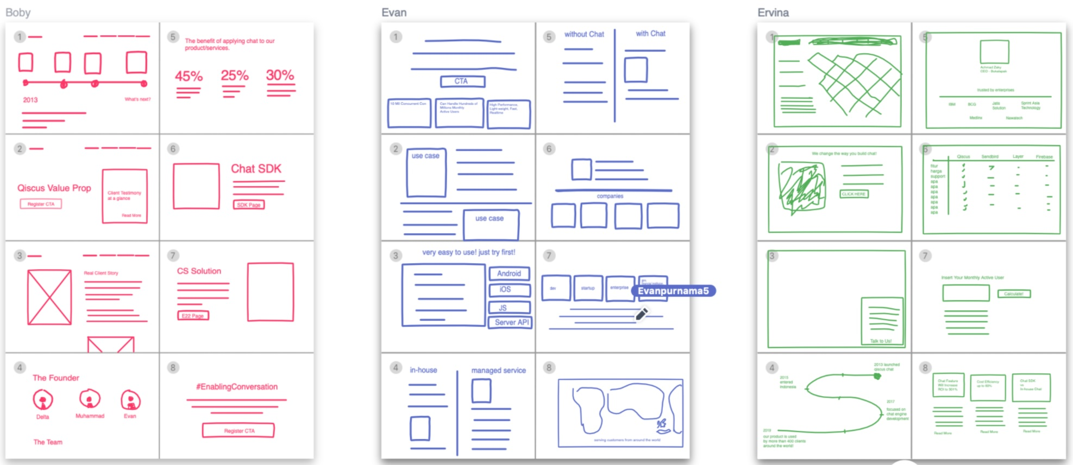

Slide 28
Mobile First
Prototype mobile-first or progressive enhancement starts with the smallest screen and adjusts the layout as you scale the viewport (this applies to mobile and web design.
Scaling up is much easier than scaling down because you prioritize content and avoid elaborate desktop layouts that don’t translate to mobile

Slide 29
One sketch per screen
Stick to one sketch per screen (a piece of paper).
Paper prototyping requires you to create user flows by placing pieces of paper in sequences.
You’ll also switch these around or add new screens. If you have more than one screen on a piece of paper, you lose this speed and flexibility.

Slide 30
Iterate over and over
Iterate as the ideas come to mind.
The goal is quantity, not quality.
When you create lots of paper prototype ideas, you often end up taking bits from each to get the final result—like a Lego set, but with paper.

